Slide 1

prices in European Cities
Final Project
She Goes Tech by Accenture Baltics
Python and Big data program
Inga Sodeikienė
Monika Rasimaitė

Slide 2
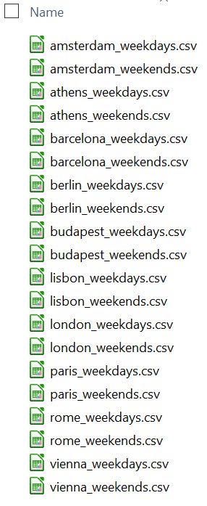
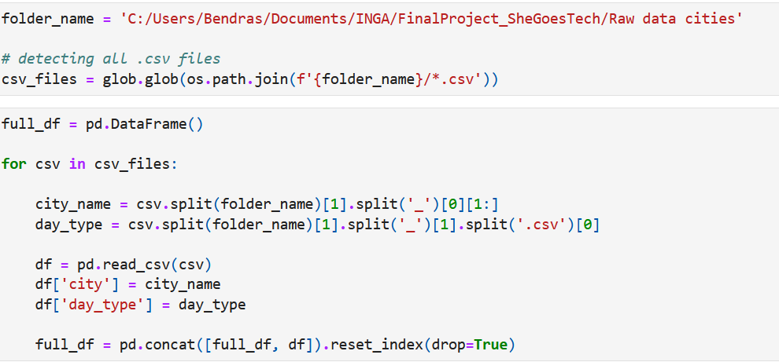
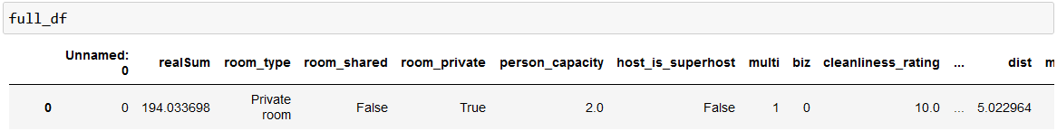
Data for the analysis

Slide 3
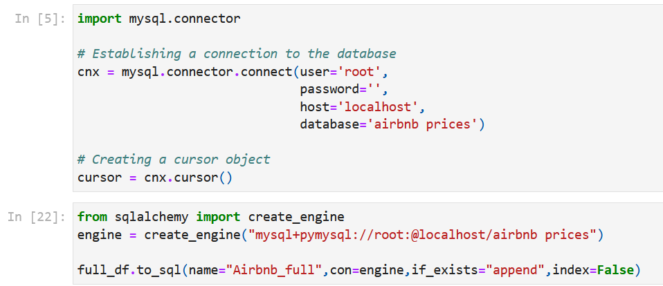
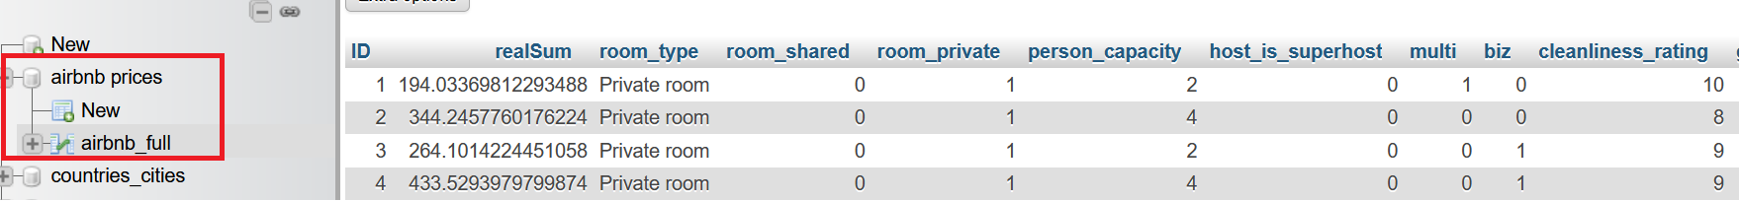
DataFrame migration

Slide 4
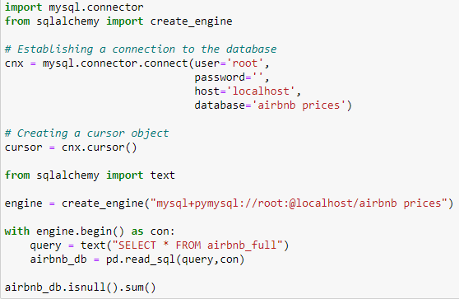
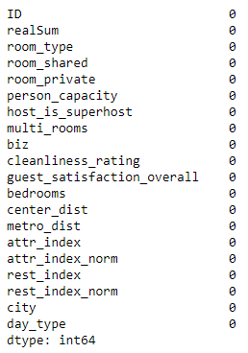
Data validation

Slide 5
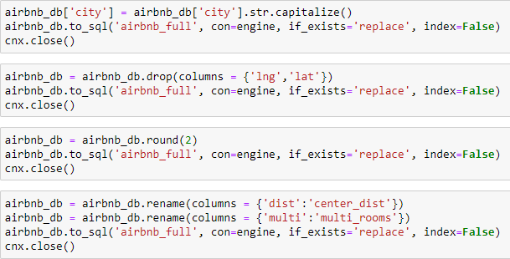
Data transformation
Capitalizing city names
Dropping unnecessary columns
Rounding all the numeric values
Renaming columns for clarity

Slide 6
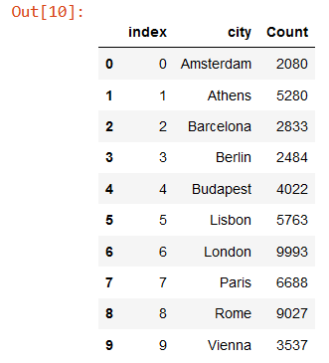
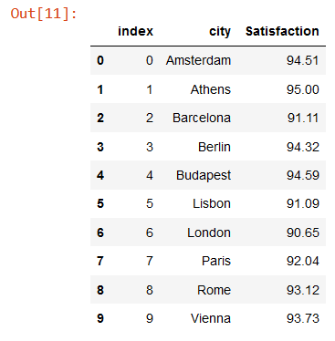
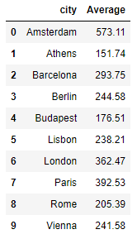
Data analysis
Average price, properties count and guest satisfaction rating

Slide 7
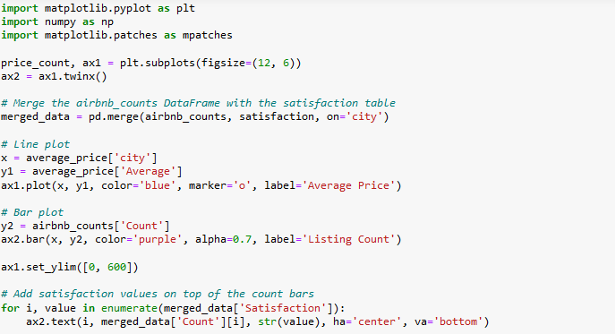
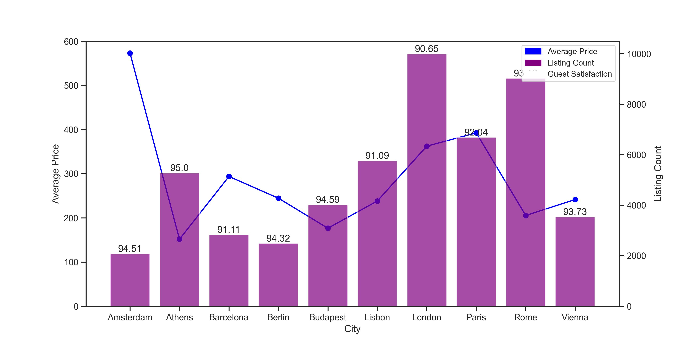
Data analysis
Average price, properties count and guest satisfaction rating

Slide 8
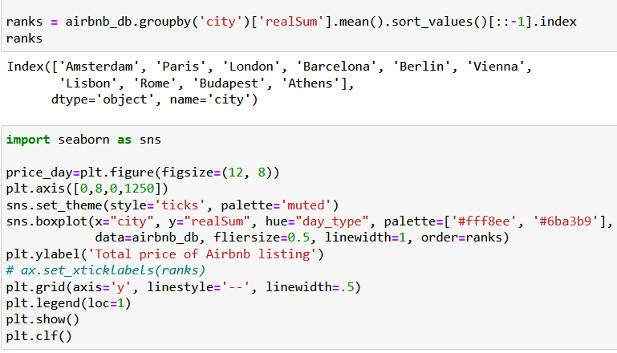
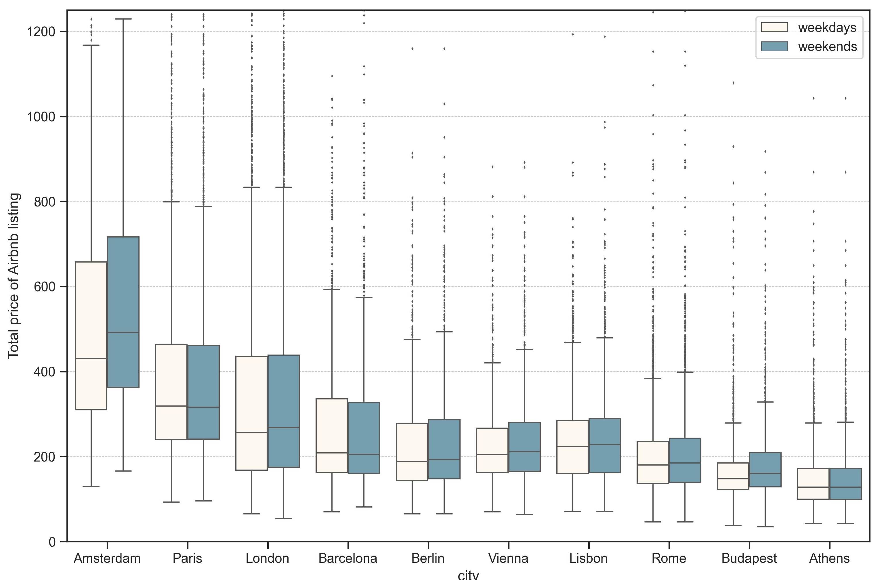
Data analysis
Price per day type

Slide 9
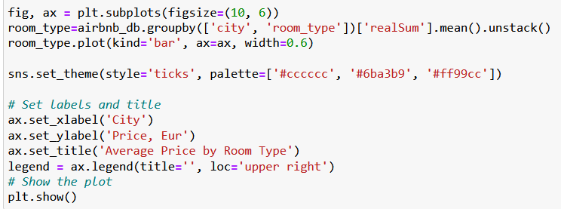
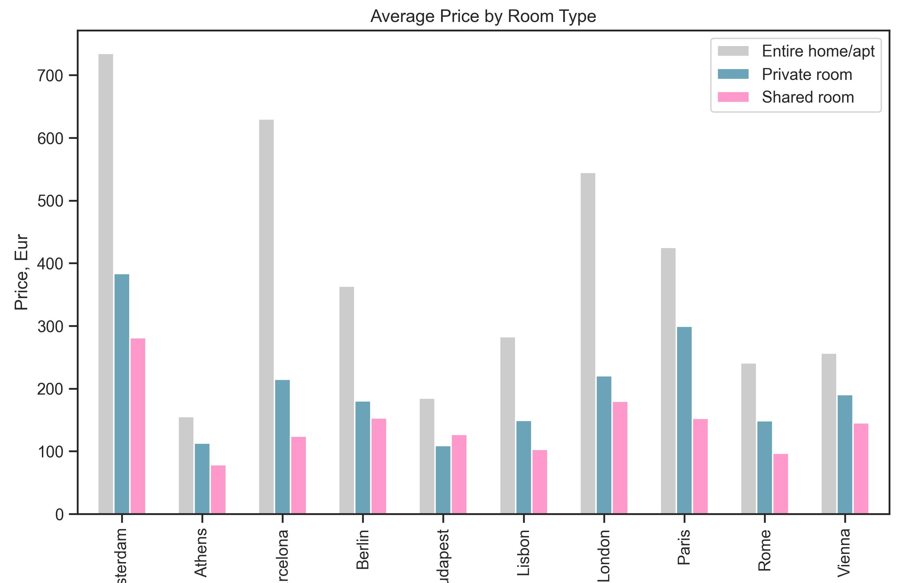
Data analysis
Average price per room type

Slide 10
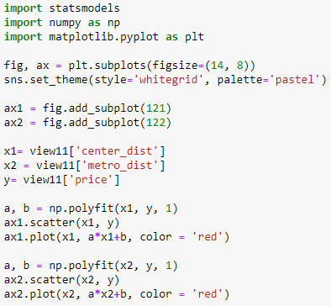
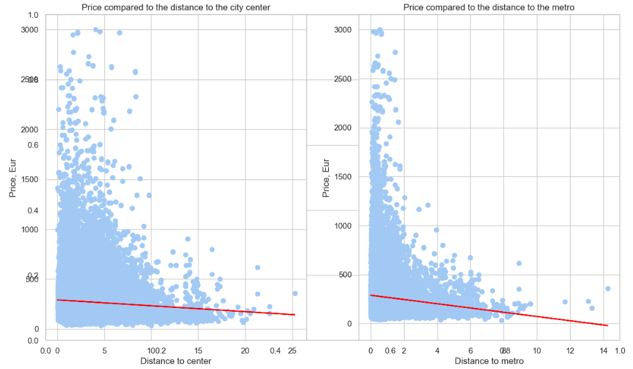
Data analysis
Distance to city center and metro impact on price

Slide 11
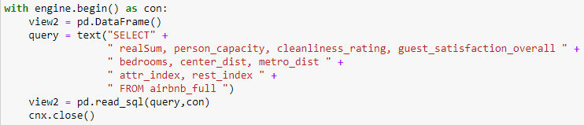
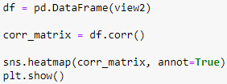
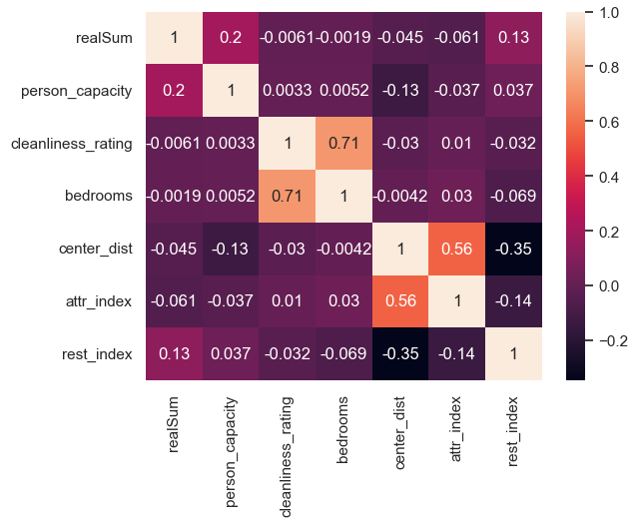
Data analysis
Correlation between different variables and the price

Slide 12

Saving the analysis files

Slide 13
Thank you for attention!

